Slide 1
Shopping Trends Analysis
Name: Senoj S
Institution: Loyola Icam college of Engineering and Technology

Slide 2
Introduction:
In today's world, where data is everywhere, predictive modeling helps us make smarter decisions.And one of the coolest tools in this area is something called decision trees. They're like a roadmap that helps us navigate through data and make predictions in a way that's easy to understand.
we're going to walk through the process of creating a predictive model using decision trees in RapidMiner.
Problem Statement:
To predict the most purchased item for a specific age group to enhance marketing strategy and sales.
The dataset used contains customer purchased products and their respective age.Based on these information we are going to build a predictive model that will show the most purchased item by a specific gender and specific age.

Slide 3
Data Preparation:
The data source is taken from kaggle.com and the data preprocessing steps are followed to remove duplicate values and fill the missing values in the dataset.
The Rapidminer tool is very useful in this as it has in built operators for doing these operations.
The dataset used for analysis is shopping_trends.csv
Using Rapidminer, we can upload the csv using read operator available inside the rapid miner tool.
Feature engineering involves creating new features or transforming existing ones to better represent the relationships within the data. This step can unlock hidden insights and improve the performance of our predictive models.
In our dataset we too included new features and gone through the feature engineering phase.

Slide 4
Attributes
Customer ID - Unique identifier for each customer
Age - Age of the customer
Gender - Gender of the customer (Male/Female)
Item Purchased - The item purchased by the customer
Category - Category of the item purchased
Purchase Amount (USD) - The amount of the purchase in USD
Location - Location where the purchase was made
Size - Size of the purchased item
Color - Color of the purchased item
Season - Season during which the purchase was made
Review Rating - Rating given by the customer for the purchased item
Subscription Status - Indicates if the customer has a subscription (Yes/No)
Shipping Type - Type of shipping chosen by the customer
Discount Applied - Indicates if a discount was applied to the purchase (Yes/No)
Promo Code Used - Indicates if a promo code was used for the purchase (Yes/No)
Previous Purchases - The total count of transactions concluded by the customer at the store, excluding the ongoing transaction
Payment Method - Customer's most preferred payment method
Frequency of Purchases - Frequency at which the customer makes purchases (e.g., Weekly, Fortnightly, Monthly)

Slide 5
Model Building:
The model is built using six decision trees and and each decision tree is fed with filtered data based on the requirement.
The data cleaning and data modifications steps are done using the operations like select attributes and generate attributes etc
Now every decision tree is connected to the output in the canva.
After this step the model gives as the decision tree with all connected nodes and we can interpret all the values from it.

Slide 6
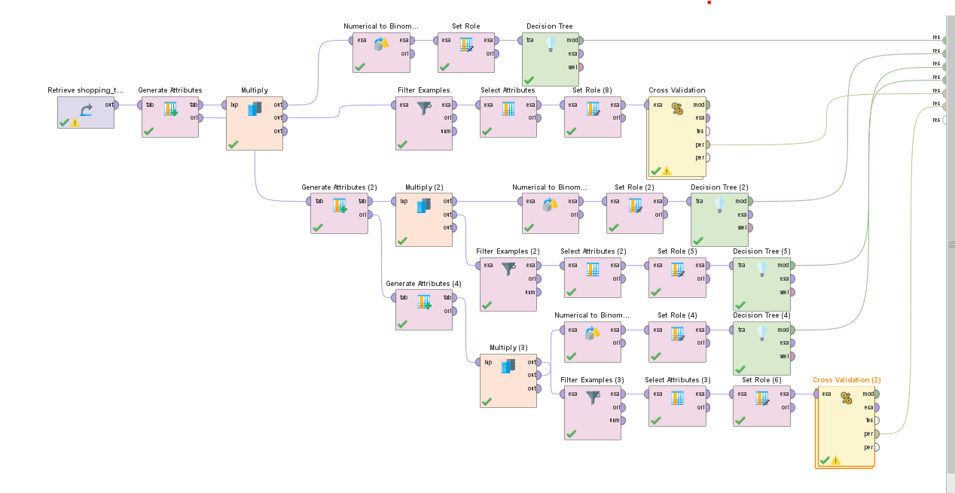
Model Design

Slide 7
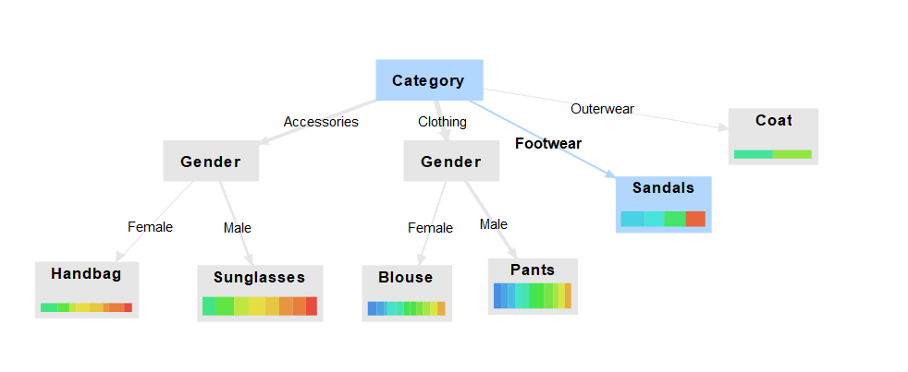
Prediction:

Slide 8
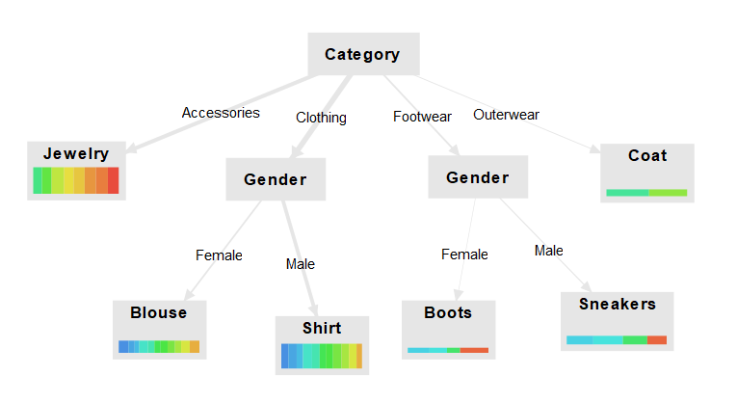

Slide 9
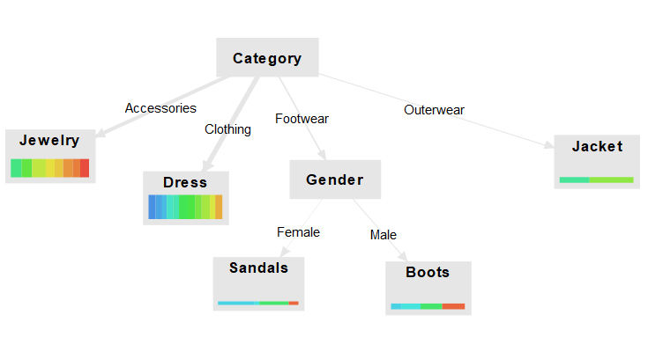

Slide 10
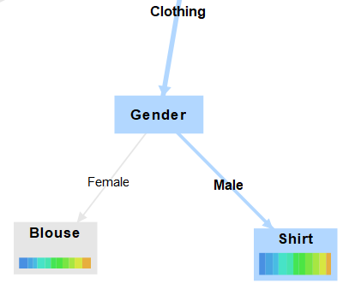
The pictures in the previous slides shows the decision tree graph and the predicted values for the age group between 20 to 40 and 40 to 60 and 60 to 70 respectively.
For Instance:
In this subdivision,People who fall under the range between 20 and 40 age group purchased comparatively Blouses(Female) and Shirts(Male) than any other product item.By this we can predict the future purchases for this age group and provide valid suggestions in marketing.

Slide 11
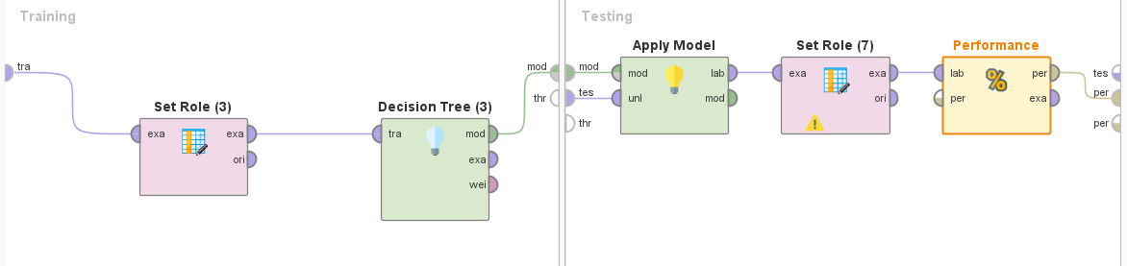
Validation:
In this Project we are going to use Cross Validation Operator to perform validation.
The Decision Tree’s predicted values are passed into the Cross validation operator.
Inside the Cross Validation operator the testing and training of data takes place.
Finally, We set the parameters that we want to calculate like Accuracy, Classification error, Absolute error inside the Performance operator.

Slide 12
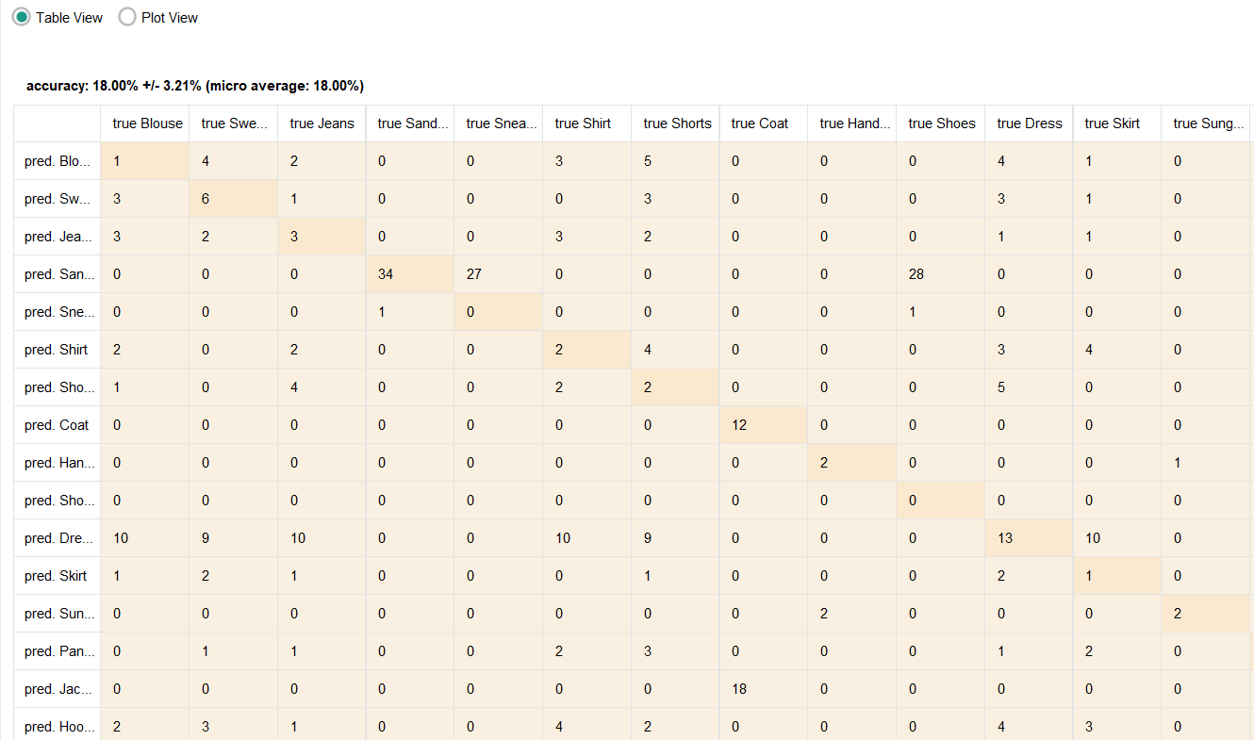
Performance Metrics
1.Accuracy:

Slide 13
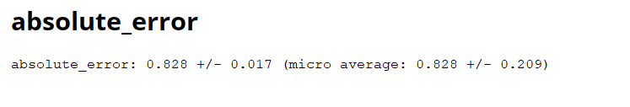
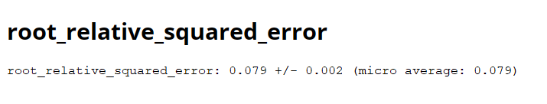
2.Absolute Error:
3.Root_Relative_Squared_Error:

Slide 14
Conclusion:
1.In conclusion, while our model has shown promising results in predicting the most purchased items for targeted age groups, there remains ample room for improvement in its overall accuracy rate.
2.By leveraging decision tree methodology, we've successfully identified patterns within specific age cohorts, providing valuable insights for targeted marketing strategies.
3.However, it's evident that our current model's simplicity may limit its predictive capabilities, particularly in capturing nuanced relationships within the data.
4.Looking ahead, employing more complex models and techniques could substantially enhance the accuracy and robustness of our predictions.

